Slide 1
Mehran S. Fallah
October 2020
Game Theory
Session III
Games in Strategic Form (2)

Slide 2


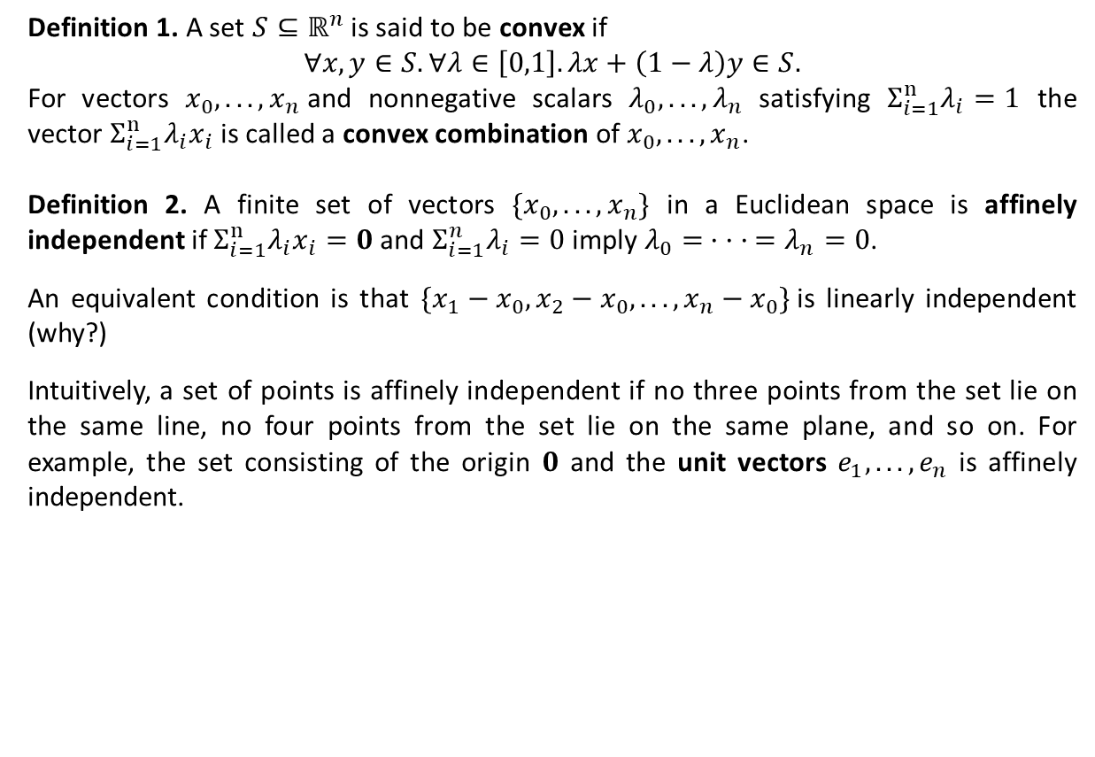


Existence of Nash Equilibrium
Definition 1. A set $S⊆ℝ^{n}$ is said to be convex if
$∀x,y∈S. ∀λ∈\left[0,1\right].λx+\left(1−λ\right)y∈S.$
For vectors $x_{0}, . . . , x_{n}$and nonnegative scalars $λ_{0}, . . . , λ_{n}$ satisfying $Σ_{i=1}^{n}λ_{i}=1$ the vector $Σ_{i=1}^{n}λ_{i}x_{i}$ is called a convex combination of $x_{0}, . . . , x_{n}$.
Definition 2. A finite set of vectors ${\{x}_{0}, . . . , x_{n}\}$ in a Euclidean space is affinely independent if $Σ_{i=1}^{n}λ_{i}x_{i}=0$ and $Σ_{i=1}^{n}λ_{i}=0$ imply $λ_{0}= · · · =λ_{n}=0$.
An equivalent condition is that $\{x_{1}−x_{0}, x_{2}−x_{0}, . . . , x_{n}−x_{0}\}$is linearly independent (why?)
Intuitively, a set of points is affinely independent if no three points from the set lie on the same line, no four points from the set lie on the same plane, and so on. For example, the set consisting of the origin $0$ and the unit vectors $e_{1}, . . . , e_{n}$ is affinely independent.
$$e_{3}$$
$$0$$
$$e_{2}$$
$$e_{1}$$

Slide 3


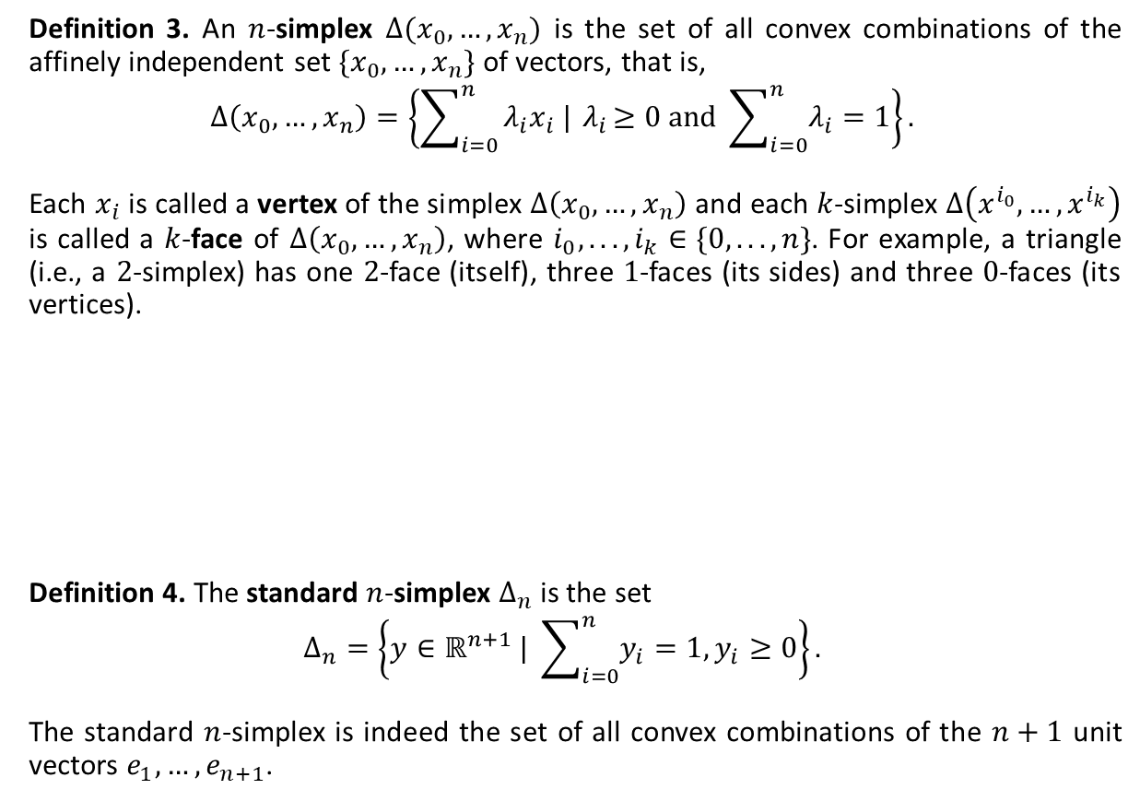


Existence of Nash Equilibrium
Definition 3. An $n$-simplex $Δ(x_{0},…,x_{n})$ is the set of all convex combinations of the affinely independent set $\{x_{0},…,x_{n}\}$ of vectors, that is,
$$Δ\left(x_{0},…,x_{n}\right)=\left\{\sum_{i=0}^{n}{λ_{i}x_{i} |{ λ}_{i}≥0 and \sum_{i=0}^{n}{λ_{i}=1}}\right\}.$$
Each $x_{i}$ is called a vertex of the simplex $Δ\left(x_{0},…,x_{n}\right)$ and each $k$-simplex $Δ\left(x^{i_{0}},…,x^{i_{k}}\right)$ is called a $k$-face of $Δ\left(x_{0},…,x_{n}\right)$, where $i_{0}, . . . , i_{k}∈\{0, . . . , n\}$. For example, a triangle (i.e., a $2$-simplex) has one $2$-face (itself), three $1$-faces (its sides) and three $0$-faces (its vertices).
Definition 4. The standard $n$-simplex $Δ_{n}$ is the set
$$Δ_{n}=\left\{y∈ℝ^{n+1} | \sum_{i=0}^{n}{y_{i}=1, y_{i}≥0}\right\}.$$
The standard $n$-simplex is indeed the set of all convex combinations of the $n+1$ unit vectors $e_{1}, …,e_{n+1}$.
$$e_{3}$$
$$Δ(e_{1},e_{2},e_{3})$$
$$e_{2}$$
$$e_{1}$$
$$Δ_{2}$$

Slide 4

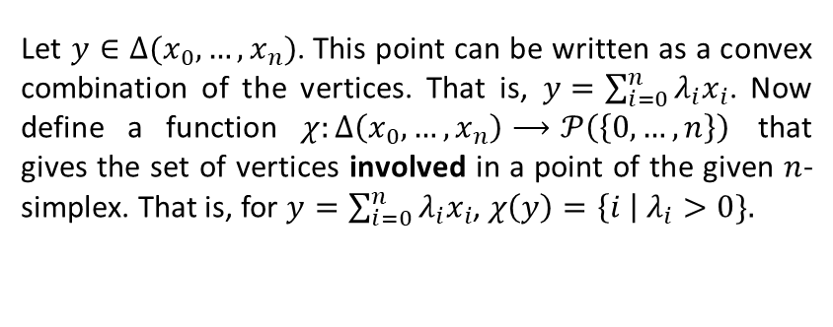

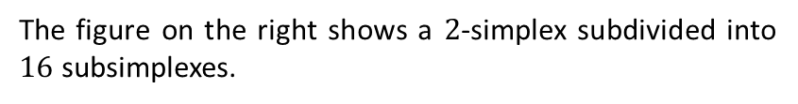
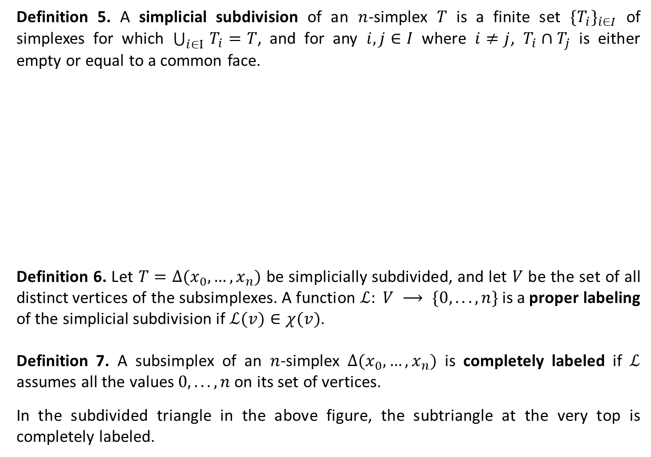





Existence of Nash Equilibrium
Definition 5. A simplicial subdivision of an $n$-simplex $T$ is a finite set ${\{T_{i}\}}_{i∈I}$ of simplexes for which $\bigcup_{i∈I }{T_{i}}=T$, and for any $i,j∈I$ where $i≠j$, $T_{i}∩T_{j}$ is either empty or equal to a common face.
Definition 6. Let $T=Δ(x_{0},…,x_{n})$ be simplicially subdivided, and let $V$ be the set of all distinct vertices of the subsimplexes. A function $ℒ: V ⟶ \{0, . . . , n\}$is a proper labeling of the simplicial subdivision if $ℒ(v)∈χ(v)$.
Definition 7. A subsimplex of an $n$-simplex $Δ(x_{0},…,x_{n})$ is completely labeled if $ℒ$ assumes all the values $0, . . . , n$on its set of vertices.
In the subdivided triangle in the above figure, the subtriangle at the very top is completely labeled.
The figure on the right shows a $2$-simplex subdivided into $16$ subsimplexes.
$$2$$
completely labeled
$$0$$
$$1$$
Let $y∈Δ(x_{0},…,x_{n})$. This point can be written as a convex combination of the vertices. That is, $y=\sum_{i=0}^{n}{λ_{i}x_{i}}$. Now define a function $χ:Δ\left(x_{0},…,x_{n}\right)⟶𝒫\left(\left\{0,…,n\right\}\right)$ that gives the set of vertices involved in a point of the given $n$-simplex. That is, for $y=\sum_{i=0}^{n}{λ_{i}x_{i}}$, $χ\left(y\right)=\left\{i \right| λ_{i}>0\}.$
$$2$$
$$2$$
$$1$$
$$0$$
$$0$$
$$1$$
$$2$$
$$0$$
$$1$$
$$0$$
$$1$$
$$1$$

Slide 5
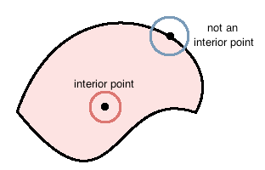
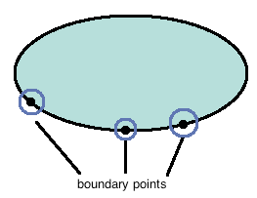
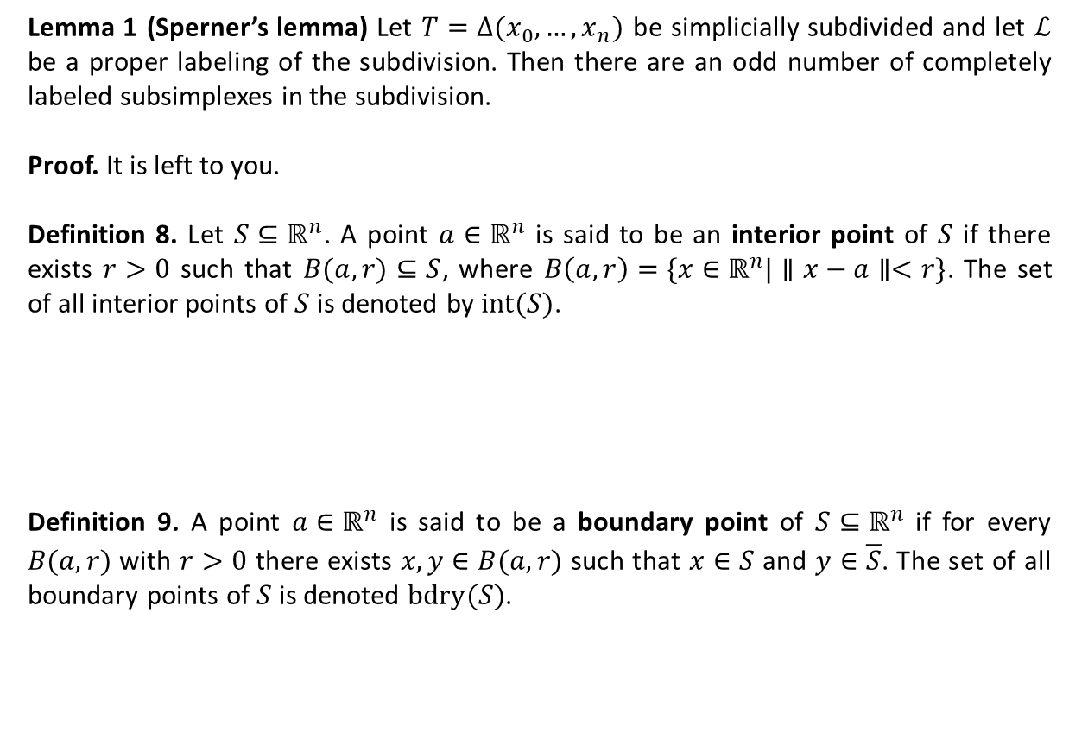
Existence of Nash Equilibrium
Lemma 1 (Sperner’s lemma) Let $T=Δ(x_{0},…,x_{n})$ be simplicially subdivided and let $ℒ$ be a proper labeling of the subdivision. Then there are an odd number of completely labeled subsimplexes in the subdivision.
Proof. It is left to you.
Definition 8. Let $S⊆ℝ^{n}$. A point $a∈ℝ^{n}$ is said to be an interior point of $S$ if there exists $r>0$ such that $B(a,r)⊆S$, where $B\left(a,r\right)=\{x∈ℝ^{n}|∥x−a∥<r\}$. The set of all interior points of $S$ is denoted by $int(S)$.
Definition 9. A point $a∈ℝ^{n}$ is said to be a boundary point of $S⊆ℝ^{n}$ if for every $B(a,r)$with $r>0$ there exists $x,y∈B(a,r)$ such that $x∈S$ and $y∈\overline{S}$. The set of all boundary points of $S$ is denoted $bdry(S)$.

Slide 6
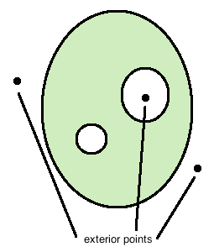
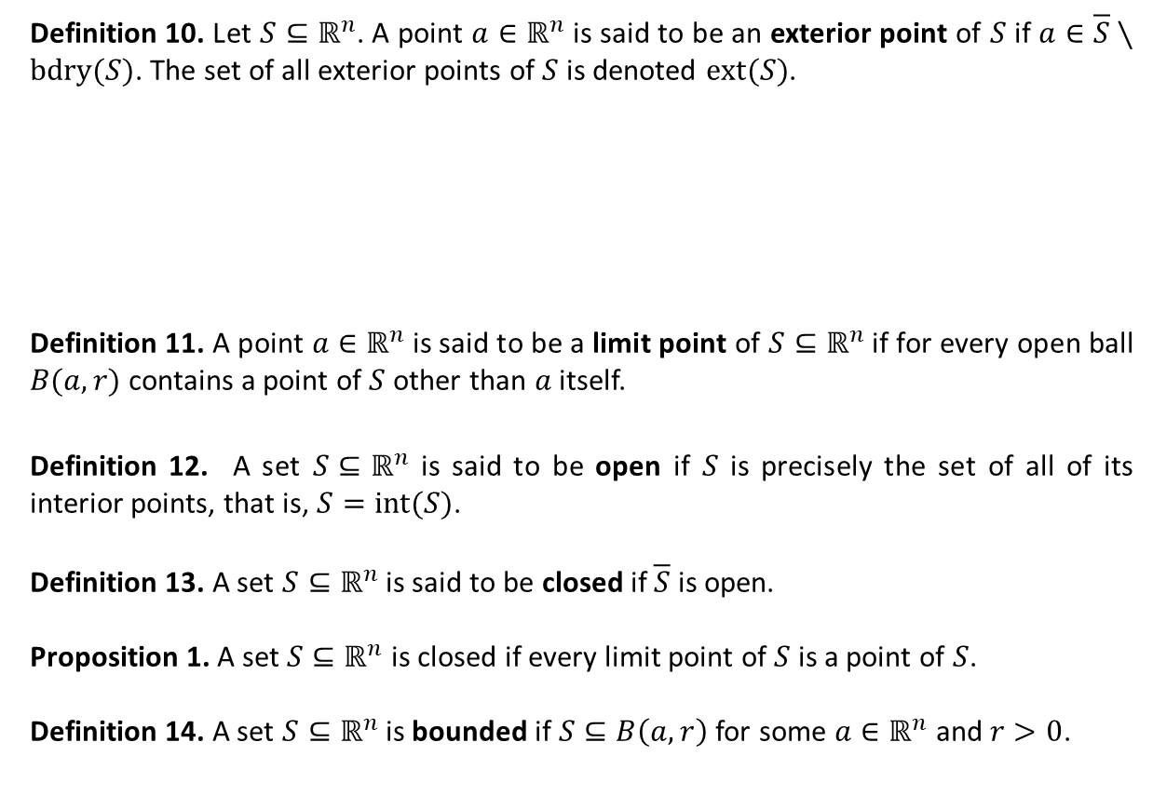
Existence of Nash Equilibrium
Definition 10. Let $S⊆ℝ^{n}$. A point $a∈ℝ^{n}$ is said to be an exterior point of $S$ if $a∈\overline{S}∖bdry(S)$. The set of all exterior points of $S$ is denoted $ext(S)$.
Definition 11. A point $a∈ℝ^{n}$ is said to be a limit point of $S⊆ℝ^{n}$ if for every open ball $B(a,r)$contains a point of $S$ other than $a$ itself.
Definition 12. A set $S⊆ℝ^{n}$ is said to be open if $S$ is precisely the set of all of its interior points, that is, $S=int(S)$.
Definition 13. A set $S⊆ℝ^{n}$ is said to be closed if $\overline{S}$ is open.
Proposition 1. A set $S⊆ℝ^{n}$ is closed if every limit point of $S$ is a point of $S$.
Definition 14. A set $S⊆ℝ^{n}$ is bounded if $S⊆B\left(a,r\right)$ for some $a∈ℝ^{n}$ and $r>0$.

Slide 7




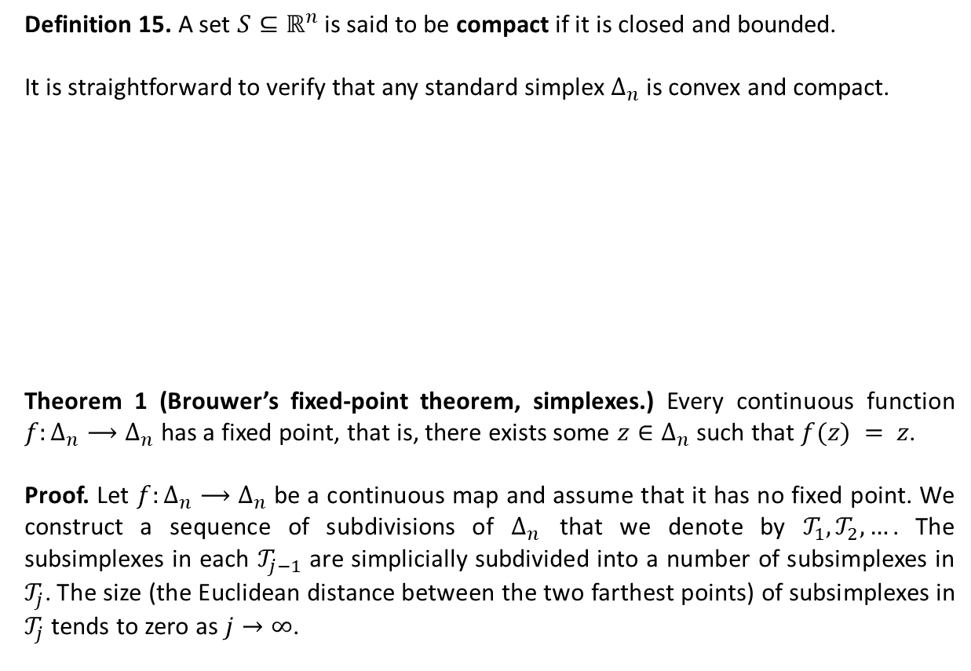




Existence of Nash Equilibrium
Definition 15. A set $S⊆ℝ^{n}$ is said to be compact if it is closed and bounded.
It is straightforward to verify that any standard simplex $Δ_{n}$ is convex and compact.
Theorem 1 (Brouwer’s fixed-point theorem, simplexes.) Every continuous function $f:Δ_{n}⟶Δ_{n}$ has a fixed point, that is, there exists some $z∈Δ_{n}$ such that $f(z) = z$.
Proof. Let $f:Δ_{n}⟶Δ_{n}$ be a continuous map and assume that it has no fixed point. We construct a sequence of subdivisions of $Δ_{n}$ that we denote by $𝒯_{1}, 𝒯_{2}, …$. The subsimplexes in each $𝒯_{j−1}$ are simplicially subdivided into a number of subsimplexes in $𝒯_{j}$. The size (the Euclidean distance between the two farthest points) of subsimplexes in $𝒯_{j}$ tends to zero as $j→∞$.
$$e_{2}$$
$$e_{3}$$
$$Δ_{1}$$
$$Δ_{2}$$
$$e_{2}$$
$$e_{1}$$
$$e_{1}$$

Slide 8
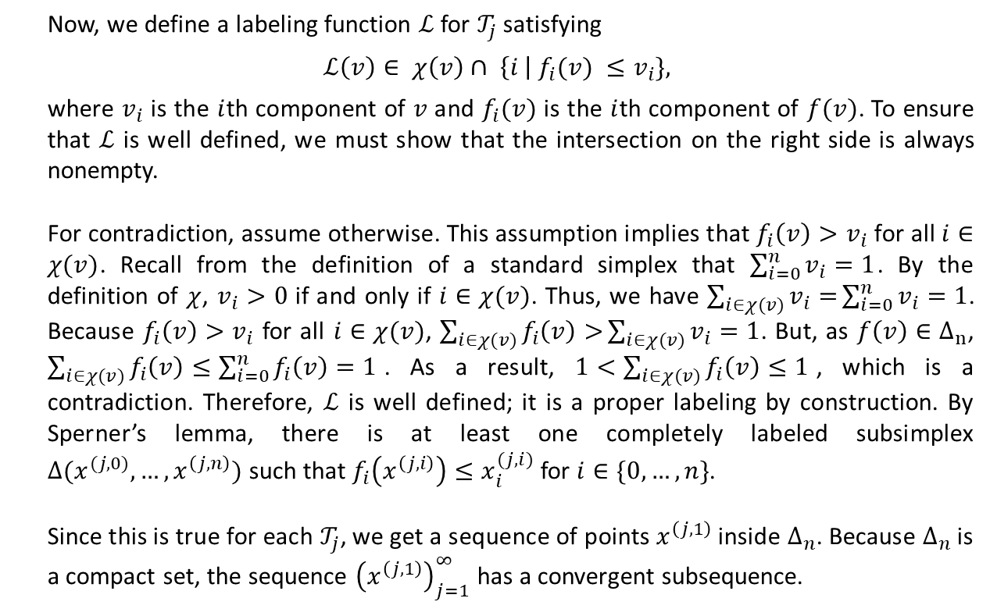
Existence of Nash Equilibrium
Now, we define a labeling function $ℒ$ for $𝒯_{j}$ satisfying
$$ℒ\left(v\right)∈ χ\left(v\right)∩ \left\{i \right| f_{i}(v) ≤v_{i}\},$$
where $v_{i}$ is the $i$th component of $v$ and $f_{i}(v)$ is the $i$th component of $f(v)$. To ensure that $ℒ$ is well defined, we must show that the intersection on the right side is always nonempty.
For contradiction, assume otherwise. This assumption implies that $f_{i}\left(v\right)>v_{i}$ for all $i∈χ(v)$. Recall from the definition of a standard simplex that $\sum_{i=0}^{n}{v_{i}}=1$. By the definition of $χ$, $v_{i}>0$ if and only if $i∈χ(v)$. Thus, we have $\sum_{i∈χ(v)}{v_{i}=}\sum_{i=0}^{n}{v_{i}}=1$. Because $f_{i}\left(v\right)>v_{i}$ for all $i∈χ(v)$, $\sum_{i∈χ(v)}{f_{i}\left(v\right)>}\sum_{i∈χ(v)}{v_{i}=1}$. But, as $f\left(v\right)∈Δ_{n}$, $\sum_{i∈χ(v)}{f_{i}\left(v\right)≤\sum_{i=0}^{n}{f_{i}\left(v\right)=1}}$. As a result, $1<\sum_{i∈χ(v)}{f_{i}\left(v\right)≤1}$, which is a contradiction. Therefore, $ℒ$ is well defined; it is a proper labeling by construction. By Sperner’s lemma, there is at least one completely labeled subsimplex ${Δ(x}^{(j,0)},…,x^{\left(j,n\right)})$ such that $f_{i}\left(x^{\left(j,i\right)}\right)≤x_{i}^{(j,i)}$ for $i∈\{0,…,n\}$.
Since this is true for each $𝒯_{j}$, we get a sequence of points $x^{\left(j,1\right)}$ inside $Δ_{n}$. Because $Δ_{n}$ is a compact set, the sequence ${\left(x^{\left(j,1\right)}\right)}_{j=1}^{∞}$ has a convergent subsequence.

Slide 9
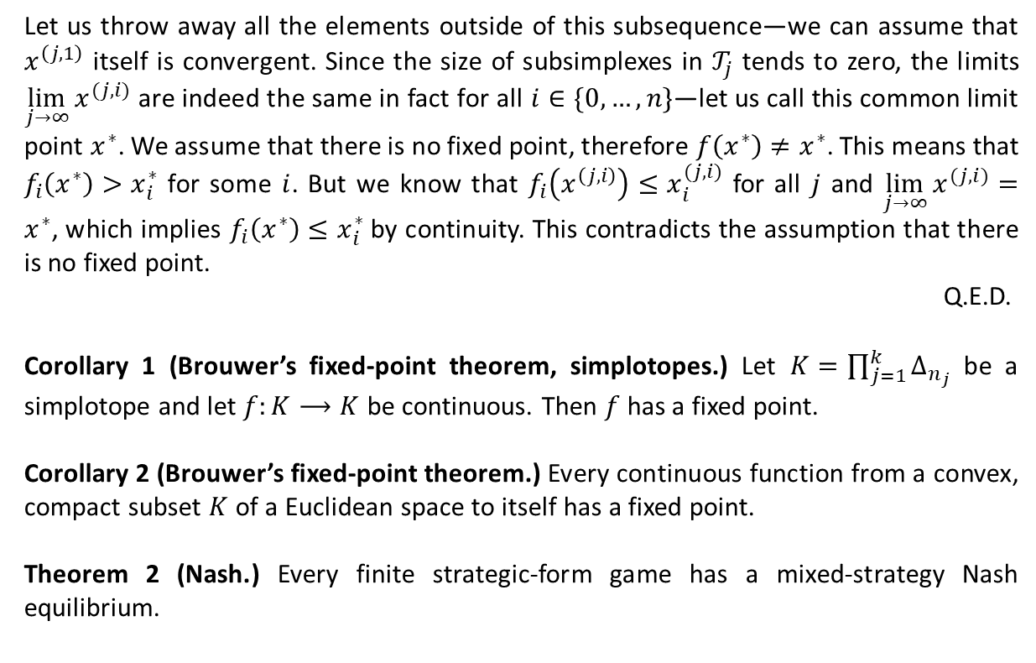
Existence of Nash Equilibrium
Let us throw away all the elements outside of this subsequence—we can assume that $x^{\left(j,1\right)}$ itself is convergent. Since the size of subsimplexes in $𝒯_{j}$ tends to zero, the limits $\lim_{j→∞}{x^{(j,i)}}$ are indeed the same in fact for all $i∈\{0,…,n\}$—let us call this common limit point $x^{∗}$. We assume that there is no fixed point, therefore $f\left(x^{∗}\right)≠x^{∗}$. This means that $f_{i}\left(x^{∗}\right)>x_{i}^{∗}$ for some $i$. But we know that $f_{i}\left(x^{\left(j,i\right)}\right)≤x_{i}^{(j,i)}$ for all $j$ and $\lim_{j→∞}{x^{(j,i)}}=x^{∗}$, which implies $f_{i}\left(x^{∗}\right)≤x_{i}^{∗}$ by continuity. This contradicts the assumption that there is no fixed point.
Q.E.D.
Corollary 1 (Brouwer’s fixed-point theorem, simplotopes.) Let $K=\prod_{j=1}^{k}{Δ_{n_{j}}}$ be a simplotope and let $f:K⟶K$ be continuous. Then $f$ has a fixed point.
Corollary 2 (Brouwer’s fixed-point theorem.) Every continuous function from a convex, compact subset $K$ of a Euclidean space to itself has a fixed point.
Theorem 2 (Nash.) Every finite strategic-form game has a mixed-strategy Nash equilibrium.

Slide 10
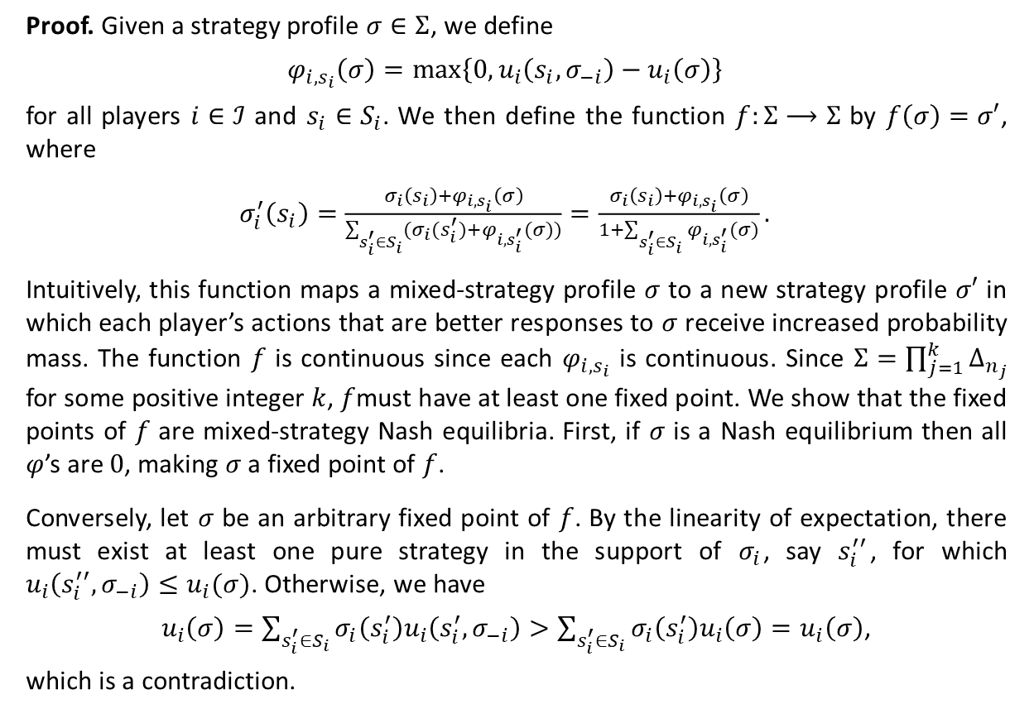
Existence of Nash Equilibrium
Proof. Given a strategy profile $σ∈Σ$, we define
$$φ_{i,s_{i}}\left(σ\right)=\max\left\{0,u_{i}\left(s_{i},σ_{−i}\right)−u_{i}\left(σ\right)\right\}$$
for all players $i∈ℐ$ and $s_{i}∈S_{i}$. We then define the function $f:Σ⟶Σ$ by $f\left(σ\right)=σ′$, where
$σ_{i}^{′}\left(s_{i}\right)=\frac{σ_{i}\left(s_{i}\right)+φ_{i,s_{i}}\left(σ\right)}{\sum_{s_{i}^{′}∈S_{i}}{(σ_{i}(s_{i}^{′})}+φ_{i, s_{i}^{′}}(σ))}=\frac{σ_{i}\left(s_{i}\right)+φ_{i,s_{i}}\left(σ\right)}{1+\sum_{s_{i}^{′}∈S_{i}}{φ_{i, s_{i}^{′}}(σ)}}.$
Intuitively, this function maps a mixed-strategy profile $σ$ to a new strategy profile $σ′$ in which each player’s actions that are better responses to $σ$ receive increased probability mass. The function $f$ is continuous since each $φ_{i,s_{i}}$ is continuous. Since $Σ=\prod_{j=1}^{k}{Δ_{n_{j}}}$ for some positive integer $k$, $f$must have at least one fixed point. We show that the fixed points of $f$ are mixed-strategy Nash equilibria. First, if $σ$ is a Nash equilibrium then all $φ$’s are $0$, making $σ$ a fixed point of $f$.
Conversely, let $σ$ be an arbitrary fixed point of $f$. By the linearity of expectation, there must exist at least one pure strategy in the support of $σ_{i}$, say $s_{i}^{′′}$, for which $u_{i}\left(s_{i}^{′′},σ_{−i}\right)≤u_{i}(σ)$. Otherwise, we have
$u_{i}\left(σ\right)=\sum_{s_{i}^{′}∈S_{i}}{σ_{i}\left(s_{i}^{′}\right)u_{i}\left(s_{i}^{′},σ_{−i}\right)}>\sum_{s_{i}^{′}∈S_{i}}{σ_{i}\left(s_{i}^{′}\right)u_{i}\left(σ\right)}=u_{i}\left(σ\right)$,
which is a contradiction.

Slide 11
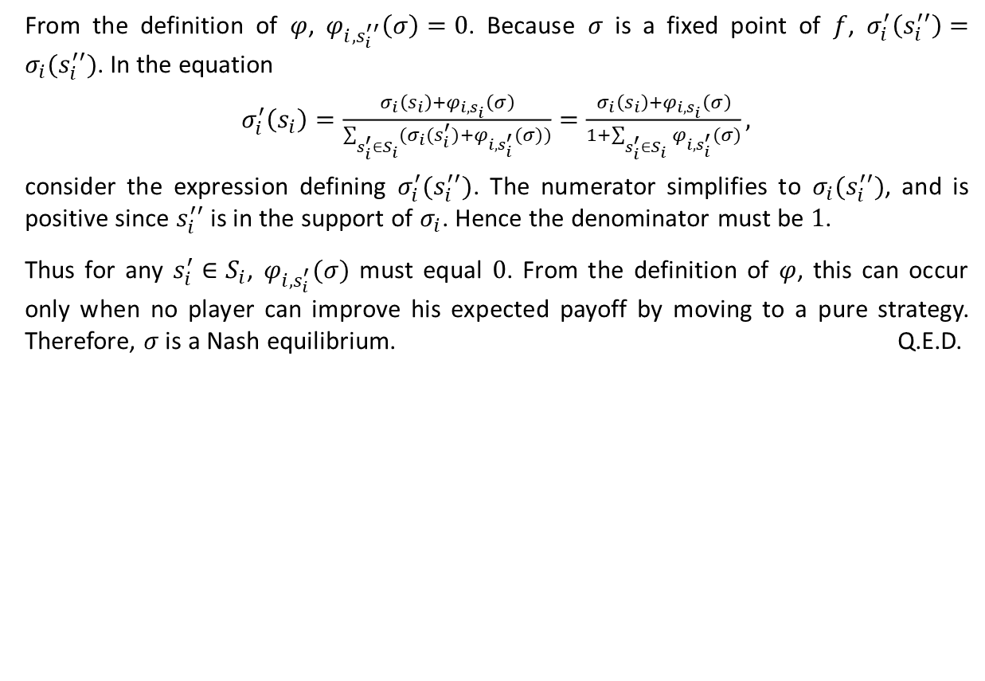
Existence of Nash Equilibrium
From the definition of $φ$, $φ_{i,s_{i}^{′′}}\left(σ\right)=0$. Because $σ$ is a fixed point of $f$, $σ_{i}^{′}\left(s_{i}^{′′}\right)=σ_{i}(s_{i}^{′′})$. In the equation
$σ_{i}^{′}\left(s_{i}\right)=\frac{σ_{i}\left(s_{i}\right)+φ_{i,s_{i}}\left(σ\right)}{\sum_{s_{i}^{′}∈S_{i}}{(σ_{i}(s_{i}^{′})}+φ_{i, s_{i}^{′}}(σ))}=\frac{σ_{i}\left(s_{i}\right)+φ_{i,s_{i}}\left(σ\right)}{1+\sum_{s_{i}^{′}∈S_{i}}{φ_{i, s_{i}^{′}}(σ)}},$
consider the expression defining $σ_{i}^{′}(s_{i}^{′′})$. The numerator simplifies to $σ_{i}(s_{i}^{′′})$, and is positive since $s_{i}^{′′}$ is in the support of $σ_{i}$. Hence the denominator must be $1$.
Thus for any $s_{i}^{′}∈S_{i}$, $φ_{i, s_{i}^{′}}(σ)$ must equal $0$. From the definition of $φ$, this can occur only when no player can improve his expected payoff by moving to a pure strategy. Therefore, $σ$ is a Nash equilibrium. Q.E.D.

